Slide 1
Distillation

Slide 2
Distillation is a method of separating the components of a solution which depends upon the distribution of the substances between a gas (vapour) and a liquid phase, applied to cases where all components are present in both phases.
Distillation as a Mass Transfer Operation
Distillation vs. Evaporation

Slide 3
Importance of Vapour-Liquid Equilibrium (V-LE)
Successful application of distillation methods depends greatly upon an understanding of the equilibrium existing between the vapour and liquid phases of the mixtures encountered.
Phase rule applies to Vapour-Liquid systems:
F = C – P + 2
For binary systems:
Variables are: Pressure, Temperature and Concentrations of one component in the liquid and vapour phases
and F = 2.
If the pressure is fixed, only one variable, e.g., liquid phase concentration, can be changed independently and temperature and vapour phase concentration follow.

Slide 4
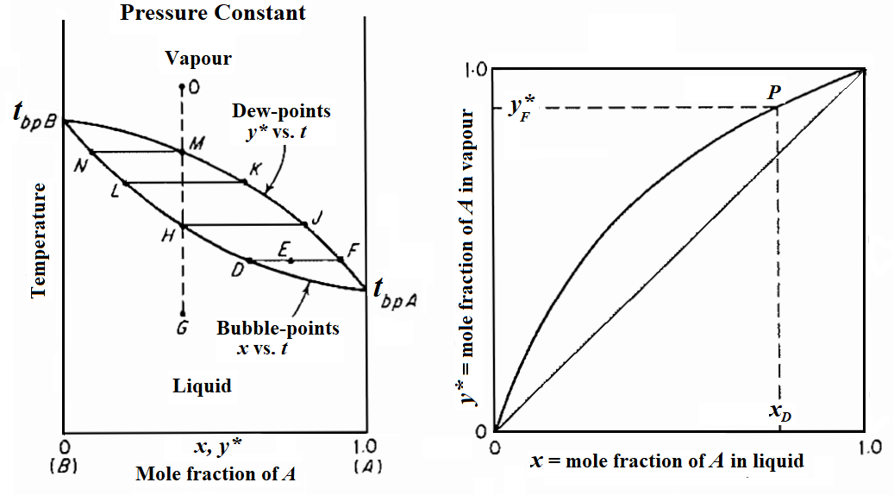
Constant pressure vapour-liquid equilibria

Slide 5
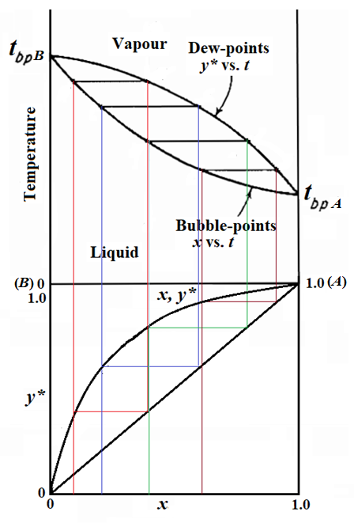
Relative volatility:

Slide 6
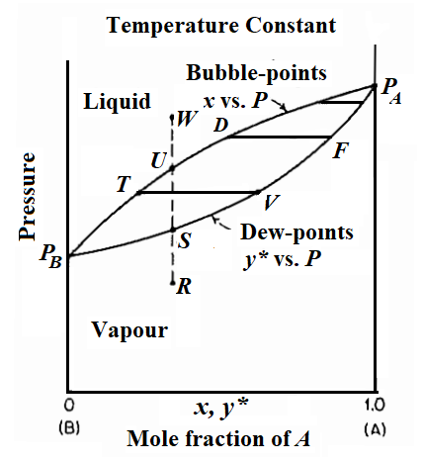
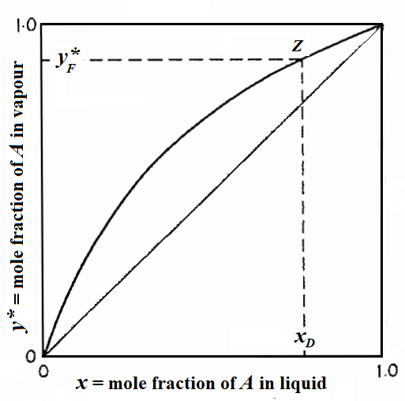
Constant temperature vapour-liquid equilibria

Slide 7
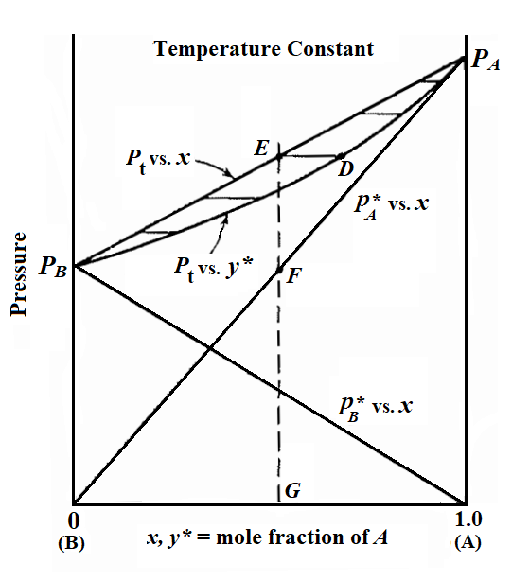
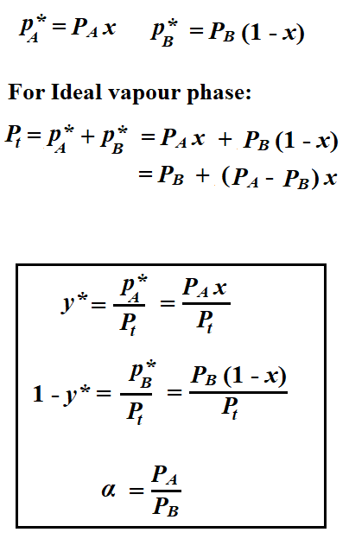
Ideal Solutions – Raoult’s Law
AB

Slide 8


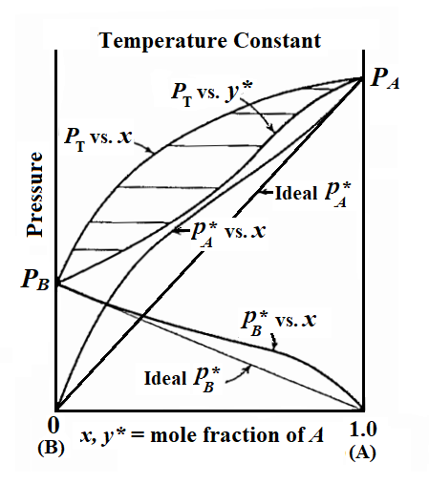
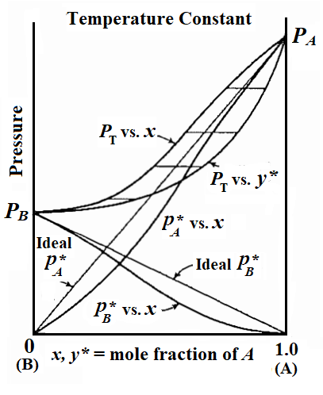
Positive Deviations from Ideality
Negative Deviations from Ideality

Slide 9
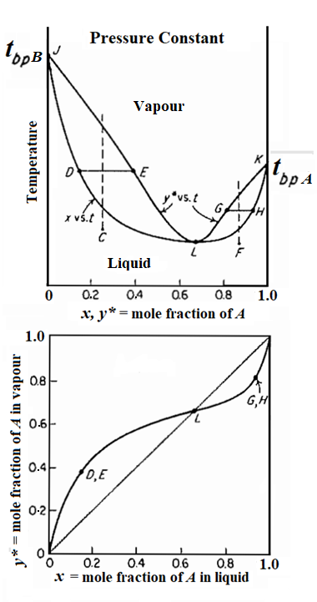
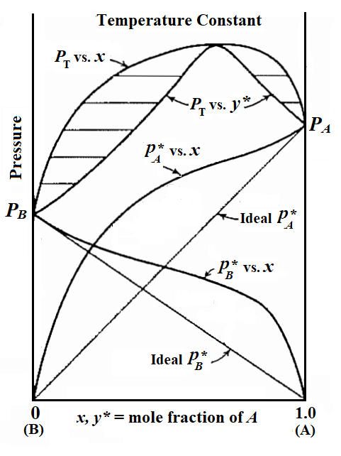
Minimum Boiling Azeotrope
Examples:
CS₂ (46.2 ºC) – Water (100 ºC) ---- Azeotrope (39.25 ºC, 61 mol% CS₂)
Ethanol (78.4 ºC) - Water (100 ºC) ---- Azeotrope (78.15 ºC, 89.4 mol% EtOH)
Acetic acid (118.1 ºC) – Toluene (110.8 ºC)
---- Azeotrope (105.4 ºC, 62.7 mol% Acetic acid)

Slide 10
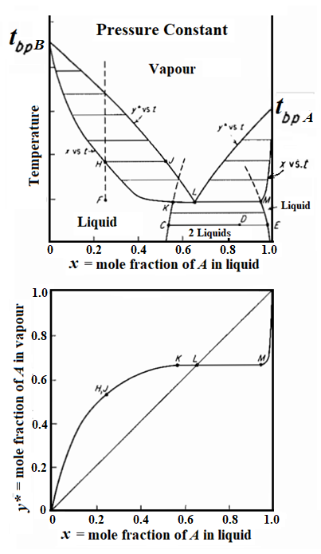
Heteroazeotrope
Isobutanol - Water
Toluene - Water

Slide 11
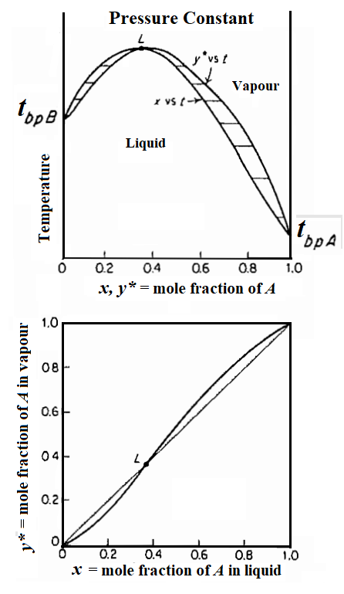
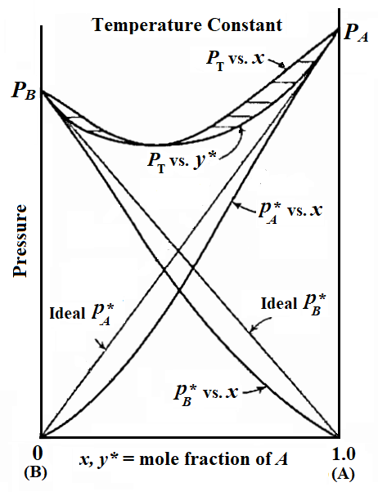
Maximum Boiling Azeotrope
Examples:
HCl (85 ºC) – Water (100 ºC) ---- Azeotrope (110 ºC, 11.1 mol% HCl)
Acetone (56.5 ºC) - Chloroform (61.2 ºC)
---- Azeotrope (64.5 ºC, 65.5 mol% Chloroform)
Water(100 ºC) – Formic acid (100.8 ºC)
---- Azeotrope (107.1 ºC, 56.7 mol% Formic acid)

Slide 12
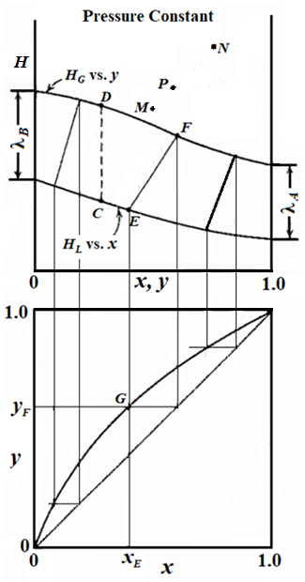
Enthalpy–Concentration (H-x, y) Diagrams
Liquid Enthalpy:
H_{L} = C_{L} (t_{L} – t_{o}) M_{av} + ΔH_{S}
Saturated Vapour Enthalpy:
H_{G} = y [C_{L, A} M_{A} (t_{G} – t_{o}) + λ_{A}]
+ (1 – y) [C_{L, B} M_{B} (t_{G} – t_{o}) + λ_{B}]
Overall material balance:
M + N = P …. (1)
A balance for component A gives:
M z_{M} + N z_{N} = P z_{P} …. (2)
An enthalpy balance gives:
M H_{M} + N H_{N} = P H_{P} …. (3)
Elimination of P between eqs. (1) & (2) and between eqs. (1) & (3) yields:
…. (4)
This is the equation of a straight line on the enthalpy-concentration plot,
passing through points M (H_{M}, z_{M}), N (H_{N}, z_{N}) and P (H_{P}, z_{P}). Point P is, therefore, on the straight line MN, located so that M/N = line NP/line PM.

Slide 13
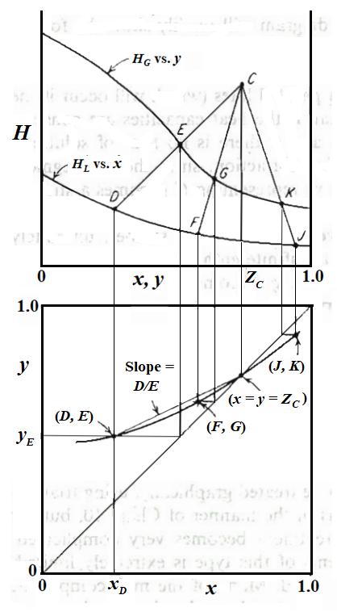
For the combination E – D = C, a material balance gives

Slide 14
Multicomponent Systems
For multicomponent system particularly, it is customary to describe the equilibrium data by means of the distribution coefficient, m. For component J,
The relative volatility α_{I, J} of component I with respect to J is
For ideal solutions,
and
Bubble Point:
For the bubble point vapour,
Or, m_{A} x_{A} + m_{B} x_{B} + m_{C} x_{C} + · · · = 1.0
With component J as a reference component,
=>
The equilibrium bubble-point vapour composition is given by

Slide 15
Dew Point:
For the dew point liquid,
Or,
With component J as a reference component,
=>
The dew-point liquid composition is given by

Slide 16
Distillation Methods
Simple Distillation
Fractional Distillation or Continuous Rectification

Slide 17
SIMPLE DISTILLATION METHODS
Equilibrium or Flash Distillation
Simple Batch or Differential Distillation
Steam Distillation

Slide 18
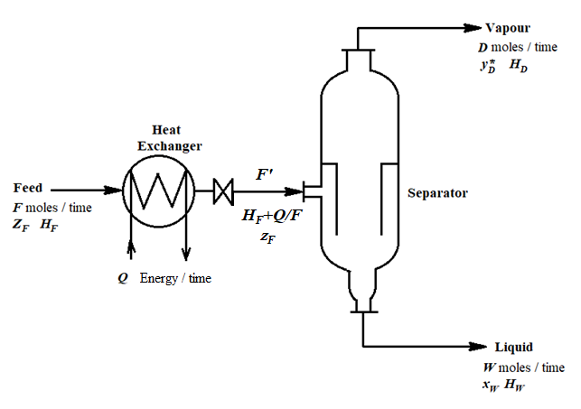
Equilibrium or Flash Distillation
Overall material balance:
F = D + W …. (5)
A balance for component A gives:
F z_{F} = D y_{D} + W x_{W} …. (6)
An enthalpy balance gives:
F H_{F} + Q = D H_{D} + W H_{W}
=> F (H_{F} + Q/F) = D H_{D} + W H_{W} …. (7)
Solved simultaneously, these yields:
…. (8)
On the H-x,y diagram, this represents a straight line through points D (H_{D}, y_{D}), W (H_{W}, x_{W}) and F' (H_{F}+Q/F, z_{F}) representing the feed mixture after it leaves the heat exchanger.

Slide 19
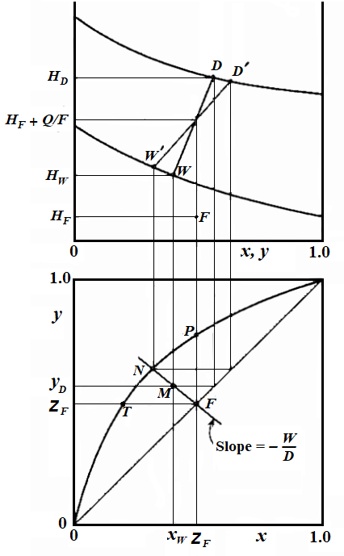
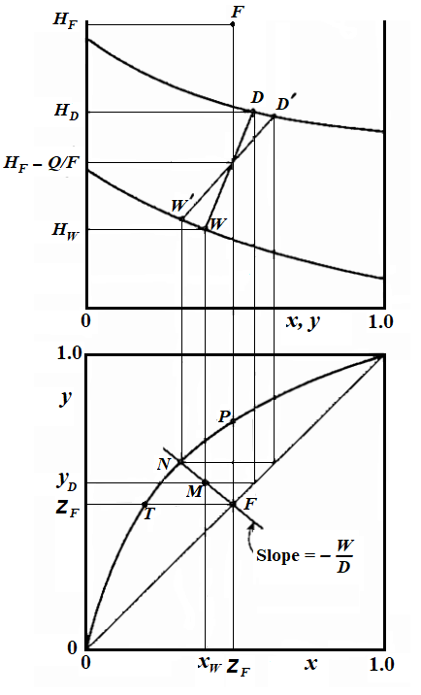
Partial Condensation

Slide 20
Multicomponent Systems - Ideal Solutions
For mixtures leaving an equilibrium stage containing components A, B, C, etc., the equilibrium relation for any component J can be written as
…. (9)
Equation (8) also applies for each of the components, and when combined with equation (9) for any component J,
for an equilibrium stage gives
…. (10)
This provides the following expression, useful for equilibrium vaporization,
…. (11a)
…. (11b)
and for partial condensation
…. (12a)
…. (12b)

Slide 21
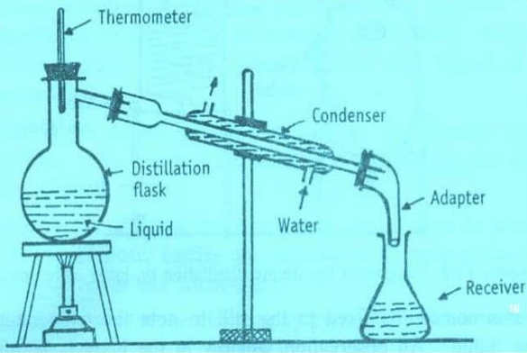
Simple Batch or Differential Distillation

Slide 22
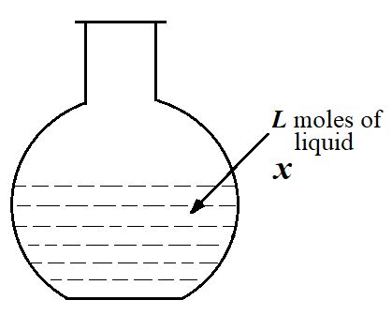
Differential Distillation
 | Total material | Component A
Moles in | 0 | 0
Moles out | dD | y* dD
Moles accumulated | dL | d(L x)
In – Out = Accumulation | 0 – dD = dL | 0 – y* dD = L dx + x dL
y* dL = L dx + x dL
…. (13)
…. (14)
Differential Condensation
Rayleigh Equation
…. (16)
…. (15)

Slide 23
Constant Relative Volatility
If we can describe the equilibrium relation at constant pressure by use of some average relative volatility, α_{av} over the concentration range involved as
…. (16)
then graphical integration can be avoided. Substituting this in Rayleigh equation yields
…. (17)
This can be rearranged to another useful form:
…. (18)
which relates the number of moles of A remaining in the residue, W x_{W} to that of B remaining W (1-x_{W}). These expressions are most likely to be valid for ideal mixtures, for which α is most nearly constant.

Slide 24
Multicomponent Systems - Ideal Solutions
For multicomponent systems forming ideal liquid solutions, Eqn. (18) can be written for any two components. Ordinarily one component is chosen on which to base the relative volatilities, whereupon Eqn.(18) is written once for each of the others. For example, for substance J, with relative volatility based on substance B,
…. (19)
and
…. (20)
Where x_{J, F} is the mole fraction of J in the feed and x_{J, W} is that in the residue.

Slide 25
Steam Distillation
At atmospheric pressure high boiling liquids cannot be purified by distillation since the components of the liquid may decompose at the high temperatures required. Often the high boiling substances are essentially insoluble in water, so a separation at lower temperatures can be obtained by steam distillation. This method is often used to separate a high boiling component from small amounts of non-volatile impurities.
If a layer of liquid water (A) and an immiscible high boiling component (B) such as a hydrocarbon are boiled at 1 atm absolute pressure, then by phase rule, for three phases and two components,
F = C – P + 2 = 2 -3 + 2 = 1 degree of freedom.
Hence, if the total pressure is fixed, the system is fixed. Since there are two liquid phases, each will exert its own vapour pressure at the prevailing temperature and cannot be influenced by presence of the other. When the sum of the separate vapour pressures equals the total pressure, the mixture boils and
P_{A} + P_{B} = P_{t}
where P_{A} is the vapour pressure of pure water and P_{B} is that of pure B. Then the vapour composition is
y_{A} = P_{A}/P_{t} and y_{B} = P_{B}/P_{t}
As long as the two liquid phases are present, the mixture will boil at the same temperature, giving a vapour of constant composition, y_{A}. The temperature is found by using the vapour pressure curves of pure A and pure B.

Slide 26
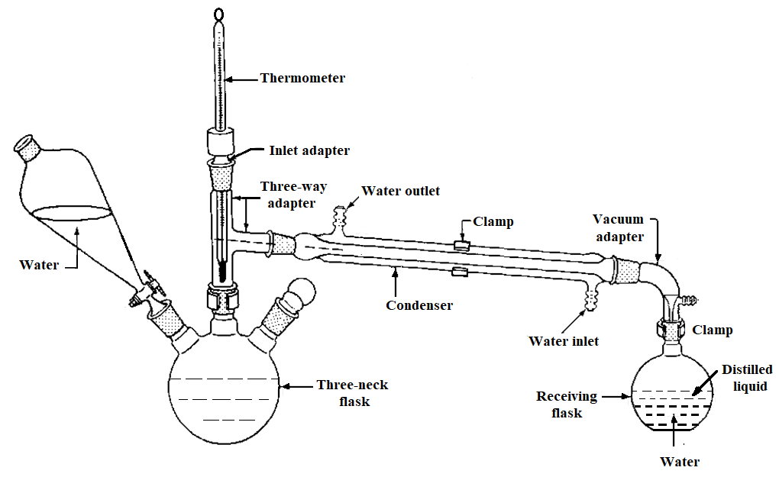
Steam Distillation Set-up

Slide 27
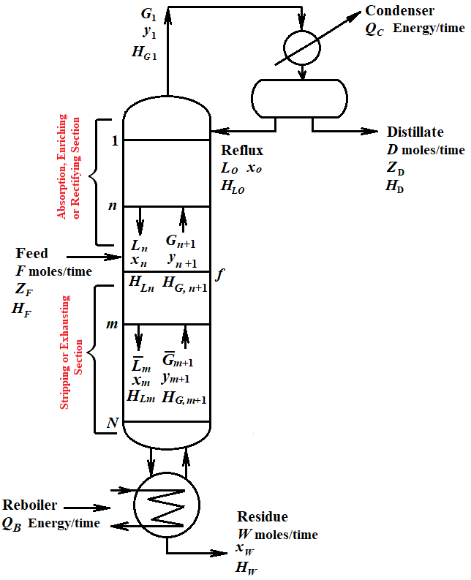
Continuous Rectification or Fractionation
Reflux ratio:
…. (1)
Total material balance over envelope I:
…. (2)
Or,
…. (3)
For substance A:
…. (4)
Enthalpy balance over envelope I provides the heat load of the condenser:
…. (5)
…. (6)
Reboiler heat load is obtained by complete enthalpy balance about the entire column:
…. (7)

Slide 28
Design of Multistage (Tray) Tower
Method of McCabe and Thiele
Method of Ponchon and Savarit

Slide 29
Design of Tray Tower - Method of McCabe and Thiele
Principle of equimolal overflow and vaporization:
The rate of liquid flow from each tray in a section of the tower is constant on a molar basis.

Slide 30
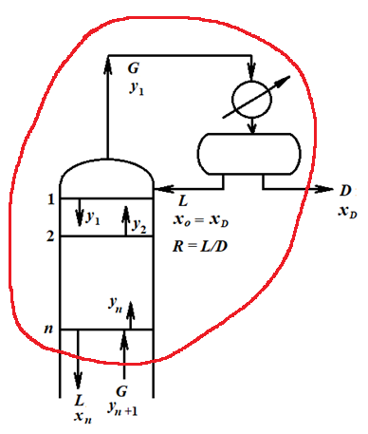
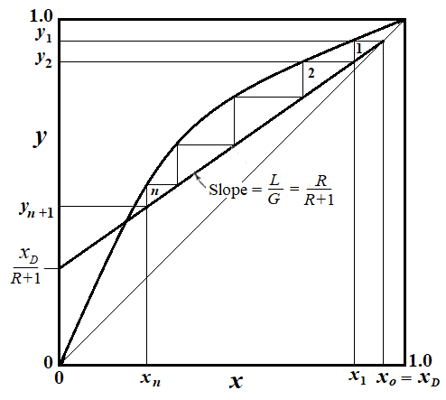
Enriching Section: Total Condenser - Reflux at the Bubble Point
A total material balance over the envelope gives:
…. (8)
For component A
…. (9)
From which the enriching section operating line is
…. (10)
P
Replacing G of Eqn. (10) by Eqn. (8) gives:
…. (11)
This is the equation of a straight line on x, y coordinates of slope
and with a y-intercept of x_{D}/(R+1).
Setting x_{n} = x_{D}, y_{n+1} = x_{D}, so that the line passes through the point x = y = x_{D} on the 45º diagonal. This point and the y-intercept permit easy construction of the operating line.
The steps cannot be carrier further than point P.

Slide 31
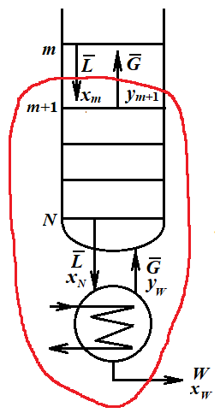
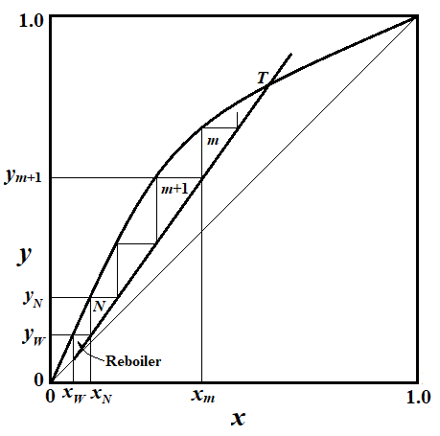
Enriching Section: Reboiled Vapour in Equilibrium with Residue
Total material balance over the envelope:
…. (12)
Component (A) material balance:
…. (13)
…. (14)
Replacing G with the help of Eqn. (12) as
…. (15)
This is a straight line of slope
and since when x_{m} = x_{W}, y_{m+1} = x_{W}, it passes through x = y = x_{W} on the 45º diagonal. If the reboiled vapour y_{W} is in equilibrium with the residue x_{W}, the first step of the staircase construction represents the reboiler.
The steps can be carrier no further than point T.

Slide 32
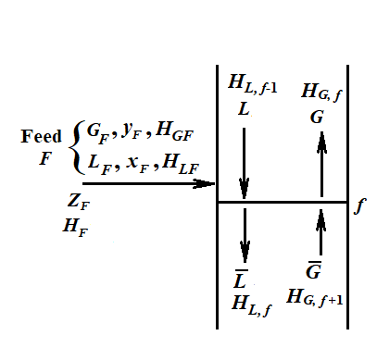
Introduction of Feed
Overall material balance near the feed tray:
…. (16)
An enthalpy balance gives
…. (17)
The vapours and liquids inside the tower are all saturated, and the molal enthalpies of all saturated vapours at this section are essentially identical since the temperature and composition changes over one tray are small. The same true of the molal enthalpies of the saturated liquids, so that H_{G f} = H_{G f+1} = H_{G} and H_{L f-1} = H_{L f} = H_{L}. Enthalpy balance Eqn. (17) then becomes
…. (18)
Combining this with Eqn. (16) gives
…. (19)
The quantity q is thus seen to be the heat required to convert one mole of fed from its condition H_{F} to a saturated vapour, divided by the molal latent heat H_{G} – H_{L}. The feed may be introduced under any of a variety of thermal conditions ranging from a liquid well below its bubble point to a superheated vapour, for each of which the value of q will be different.
Combining Eqns. (16) and (19), we get
…. (20)
.
This provides a convenient method for determining

Slide 33
The point of intersection of the two operating lines will help locate the exhausting-section operating line. This can be established as follows. Rewriting Eqns. (9) and (13) without the tray subscripts, we have
…. (21)
…. (22)
Subtracting gives
…. (23)
Further, by an overall material balance
…. (24)
Substituting this and Eqns. (19) and (20) in Eqn. (23) gives
…. (25)
This, the locus of intersection of operating lines (the q line), is a straight line of slope q/(q-1) and since y = z_{F} when x = z_{F}, it passes through the point x = y = z_{F} on the 45º diagonal. It is clear that for a given feed condition, fixing the reflux ratio at the top of the column automatically establishes the liquid/vapour ratio in the exhausting section and the reboiler heat load as well.

Slide 34
Thermal Conditions of Feed
Feed Condition | G_{F} mol/(time) | L_{F} mol/(time) | H_{GF} energy/mol | H_{LF} energy/mol | H_{F} energy/mol
Liquid below bubble point | 0 | F |  | H_{F} | H_{F} < H_{L} | > 1.0 | > 1.0
Saturated liquid | 0 | F |  | H_{F} | H_{L} | 1.0 | ∞
Mixture of liquid and vapor | G_{F} (F = G_{F} + L_{F}) | L_{F} (F = G_{F} + L_{F}) | H_{G} | H_{L} | H_{G} >H_{F} >H_{L} | L_{F}/F 1.0 > q > 0
Saturated vapor | F | 0 | H_{F} |  | H_{G} | 0 | 0
Superheated vapor | F | 0 | H_{F} |  | H_{F} >H_{G} | < 0

Slide 35
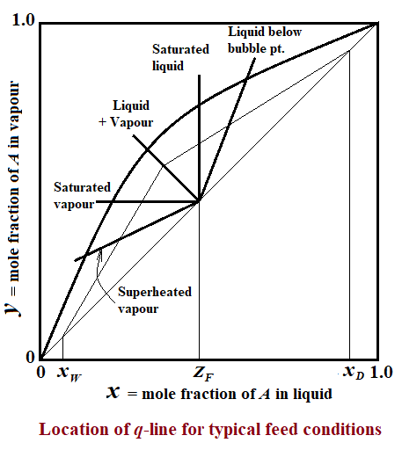

Slide 36
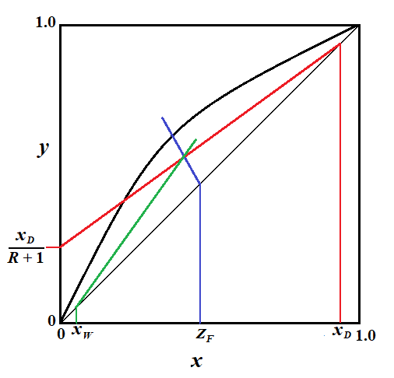

Slide 37
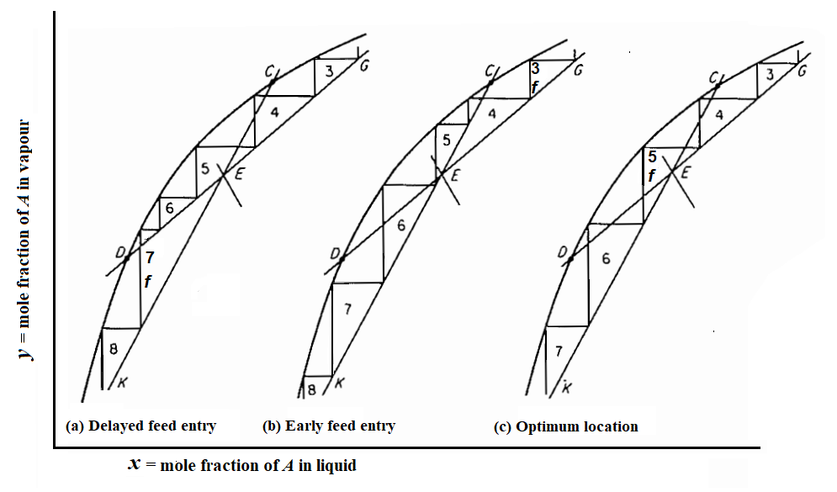
Determination of Optimum Location of Feed Tray

Slide 38
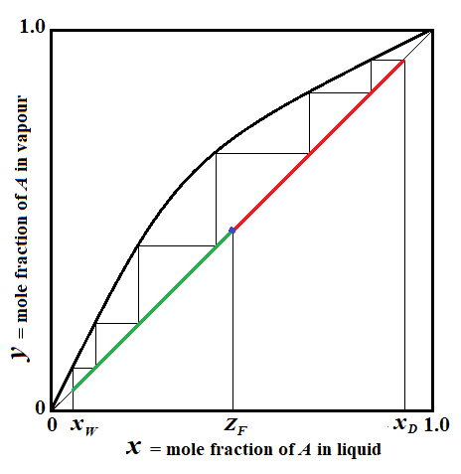
Total Reflux, or Infinite Reflux Ratio

Slide 39
Minimum Number of Trays for Constant Relative Volatility
A useful analytical expression for the minimum number of theoretical trays can be obtained for cases where the relative volatility is reasonably constant. Applying defining equation for relative volatility to the residue product gives:
…. (26)
where α_{W} is the relative volatility at the reboiler. At total reflux the operating line coincides with the 45º diagonal so that y_{W} = x_{Nm}. Therefore,
…. (27)
Similarly, for the last tray of the column, where α_{Nm} pertains,
…. (28)
This procedure can be continued up the column until ultimately
…. (29)

Slide 40
If some average relative volatility α_{av} can be used, then
…. (30)
which is known as the Fenske’s equation. The total number of theoretical stages to produce product x_{D} and x_{W} is N_{m}+1, which then includes the reboiler. For small variations in α, α_{av} can be taken as the geometric average of the values for the overhead and bottom products, . The expression can be used only with nearly ideal mixtures, for which α is nearly constant.

Slide 41
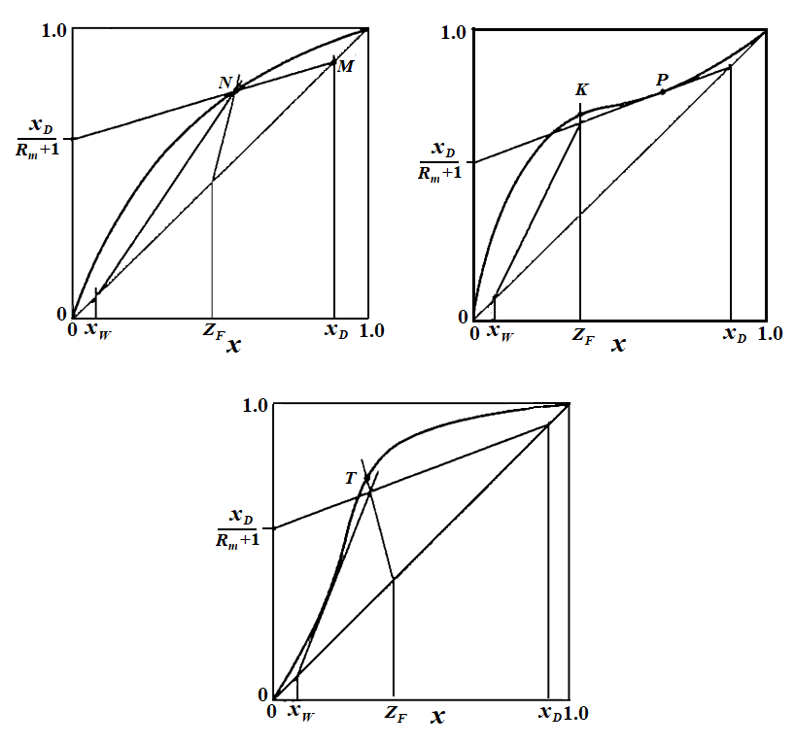
Determination of Minimum Reflux Ratio

Slide 42
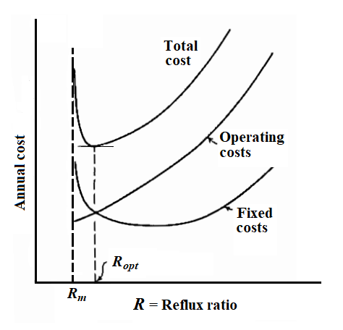

Determination of Optimum or Operating Reflux Ratio

Slide 43
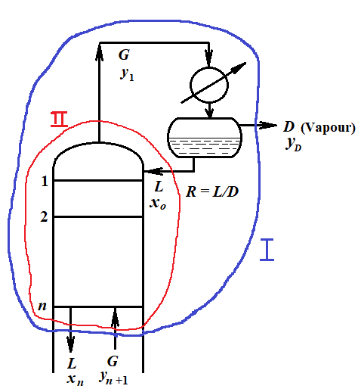
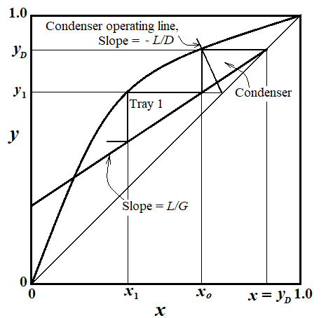
Equilibrium Partial Condenser
Envelope – I:
…. (37)
…. (38)
Envelope – II:
…. (39)

Slide 44
Cold Reflux
If the overhead vapour is condensed and cooled below its bubble point so that the reflux liquid is cold, vapour G₁ rising from the top tray will be less in quantity than that for the rest of the enriching section since some will be required to condense and heat the reflux to its bubble point. External reflux L_{o} will require heat to the extent of L_{o} C_{Lo} M_{av} (t_{bp,R} – t_{R}), where t_{bp,R} and t_{R} are the reflux bubble point and actual temperatures, respectively. An amount of vapour, L_{o} C_{Lo} M_{av} (t_{bp,R} – t_{R})/(λM)_{av}, will condense to provide the heat, and the condensed vapour adds to L_{o} to provide L, the liquid flow rate below the top tray. Therefore,
…. (40)
where R is the usual external reflux ratio, L_{o}/D. Defining an apparent reflux ratio R' by
…. (41)
gives
…. (42)
The enriching operating line becomes
…. (43)
And it is plotted through y = x = x_{D}, with a y intercept at x_{D}/(R' + 1) and a slope of R'/(R' + 1).

Slide 45
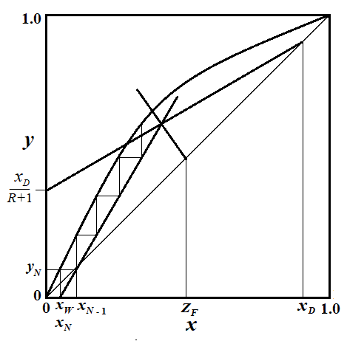
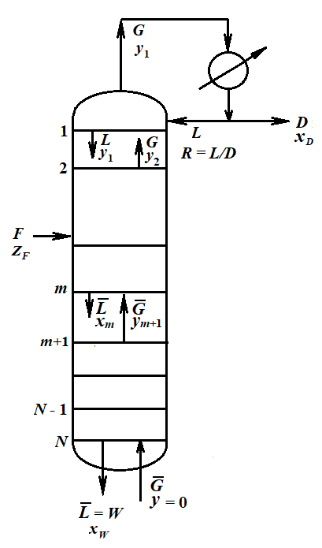
Use of Open Steam
Overall material balance:
…. (31)
Component A balance:
…. (32)
A material balance for component A below tray m in the exhausting section gives:
…. (33)
Since in this case,
…. (34)
The exhausting line, therefore, passes through the point (y = 0, x = xW) as shown in the Figure. Graphical tray construction must, therefore, be continued to the x axis of the diagram.
If the steam entering the tower, , is superheated, it will vaporize liquid on tray N to the extent necessary to bring it to saturation, , where is the enthalpy of saturated steam and the molar latent heat at the tower pressure.
…. (35)
and
…. (36)
from which the internal ratio can be computed.

Slide 46
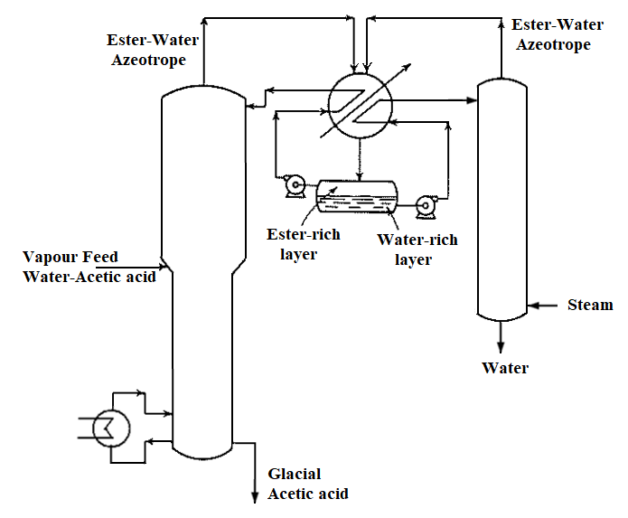
Azeotropic Distillation
Water (bp = 100 ºC) – Acetic acid (bp = 118.1 ºC)
Entrainer: Butyl acetate (bp = 181.4 ºC)
Heteroazeotrope (bp = 90.2 ºC)

Slide 47
Choice of Entrainer
The entrainer should preferably form a low-boiling azeotrope with only one of the constituents of the binary mixture it is desired to separate, preferably the constituent present in the minority so as to reduce the heat requirements of the process.
The new azeotrope must be of sufficient volatility to make it readily separable from the remaining constituent and so that inappreciable amounts of the entrainer will appear in the residue product.
It should preferably be lean in entrainer content, to reduce the amount of vaporization necessary in the distillation. It should preferably be of the heterogeneous –liquid type, which then simplifies greatly the recovery of the entrainer.
In addition, a satisfactory entrainer must be
cheap and readily available,
(2) chemically stable and inactive toward the solution to be separated,
(3) noncorrosive toward common construction materials,
(4) nontoxic,
(5) of low latent heat of vaporization,
(6) of low freezing point to facilitate storage and outdoor handling, and
(7) of low viscosity to provide high tray efficiencies.

Slide 48
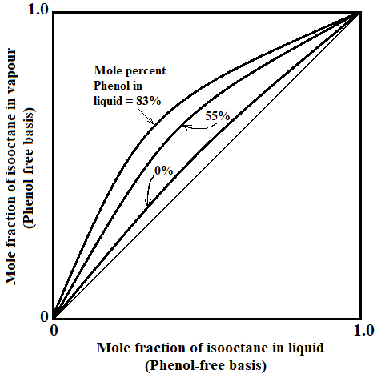
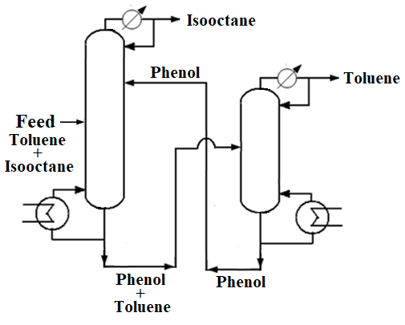
Extractive Distillation
Toluene (bp = 110.8 ºC) – Isooctane (bp = 99.3 ºC)
Solvent: Phenol (bp = 181.4 ºC)

Slide 49
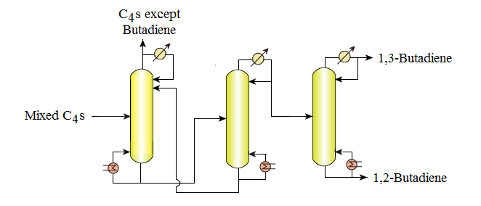
(-4.4 ºC)
(10.9 ºC)
Solvent: Acetonitrile (bp = 82 ºC)
Separation of Butadiene from Mixed C₄s by Extractive Distillation

Slide 50
Requirements of a satisfactory extractive distillation solvent are:
(1) High selectivity, or ability to alter the vapour-liquid equilibria of the original mixture sufficiently to permits its easy separation with, however, use of only small quantities of solvent.
(2) High capacity, or ability to dissolve the components in the mixture to be separated. It frequently happens that substances which are incompletely miscible with the mixture are very selective; yet if sufficiently high concentrations of solvent cannot be obtained in the liquid phase, the separation ability cannot be fully developed.
(3) Low volatility in order to prevent vaporization of the solvent with the overhead product and to maintain high concentration in the liquid phase. Nonvolatile salts can be especially useful.
(4) Separability; the solvent must be readily separated from the mixture to which it is added, and particularly it must form no azeotropes with the original substances.
(5) The same considerations of cost, toxicity, corrosive character, chemical stability, freezing point, and viscosity apply as for entrainers for azeotropic distillation.

Slide 51
Comparison of Azeotropic and Extractive Distillations
It is generally true that adding an extraneous substance such as entrainer or solvent to a process is undesirable. Since it can never be completely removed, it adds an unexpected impurity to the products. There are inevitable losses (ordinarily of the order of 0.1% of the solvent circulation rate), and they may be large since the solvent/feed ratios must frequently be greater than 3 or 4 to be effective. An inventory and source of supply must be maintained. Solvent recovery costs can be large, and new problems in choices of materials of construction are introduced. It follows that these processes can be considered only if, despite these drawbacks, the resulting process is less costly than conventional distillation.
Extractive distillation is generally considered to be more desirable than azeotropic distillation since (1) there is a greater choice of added component because the process does not depend upon the accident of azeotrope formation and (2) smaller quantities of solvent must be volatilized. However, the latter advantage can disappear if the volatilized impurity is a minor constituent of the feed and the azeotrope composition is favourable, i.e., low in solvent composition. Thus in the dehydration of ethanol from an 85.6 mole% ethanol-water solution, azeotroping the water with n-pentane as entrainer is more economical than using ethylene glycol as an extractive distillation solvent. The reverse might be true for a more dilute alcohol feed.

